Slide 1
COMP 2615
April 19, 2007
Team 5
Chet Woodside
Jen Crothers
Winter Liu
Lynda Wissmann

Slide 2
Presentation Focus
What kinds of people would take a Systems Analysis Course at BCIT in the downtown campus?
  Vital Statistics
  Education
  Personal Hobbies

Slide 3
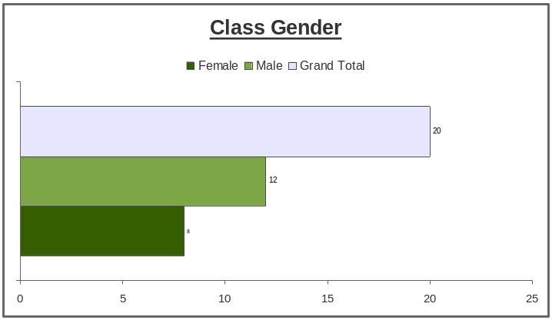
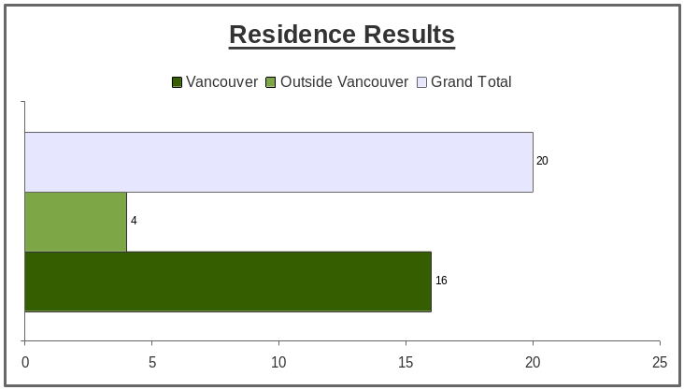
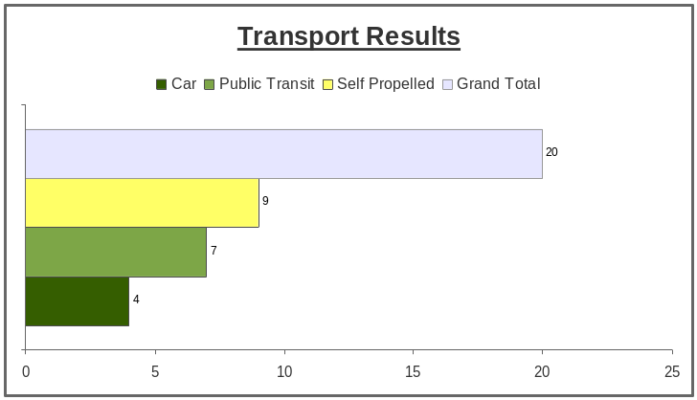
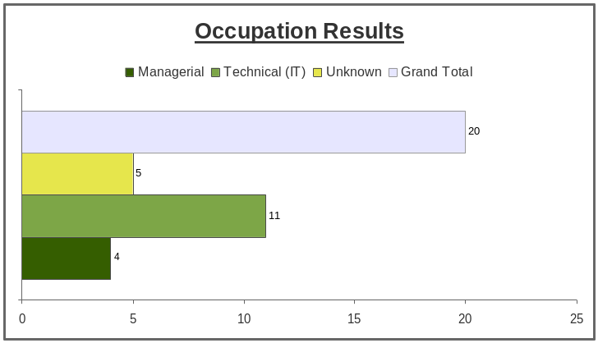
Analysis of Vital Statistics

Slide 4

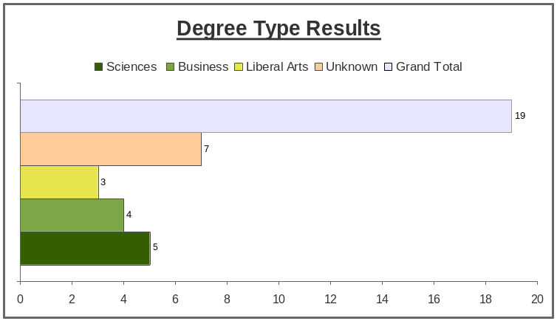
Analysis of Education

Slide 5
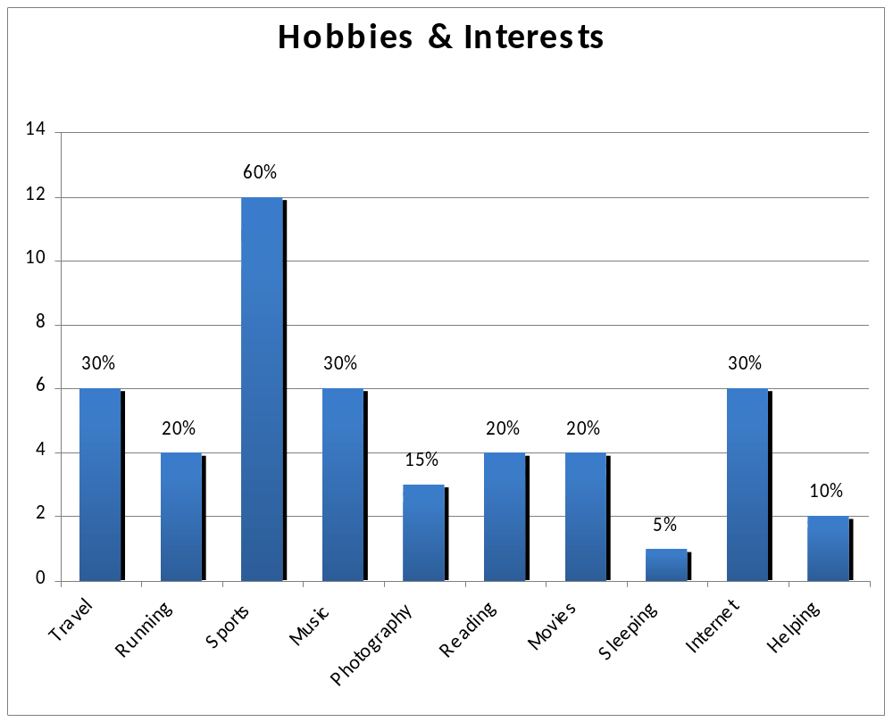
Analysis of Personal Hobbies

Slide 6
Summary
Vital Statistics
  Gender = Male (60%)
  Residence = Vancouver (80%)
  Occupation = Technical (55%)
  Transportation = Self Propelled & Public Transit (80%)
Education
  Graduate and up (65%)
  Type of degree (mixed)
Hobbies
  Sports followed by Travel, Music & Internet

